Slide 1
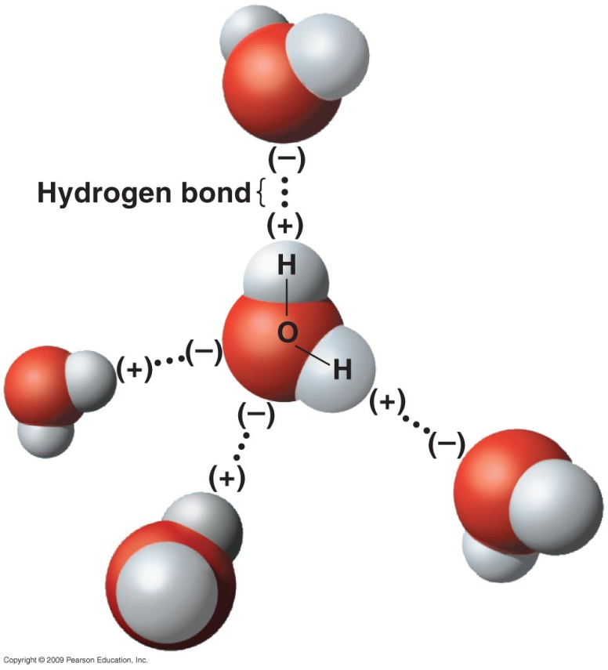
Unique Properties of Water
High melting and boiling points (0 °C and 100 °C respectively) – due to strong hydrogen bonds present between molecules (water molecules can form up to four hydrogen bonds per molecule).
(Quydyan n.d.)

Slide 2
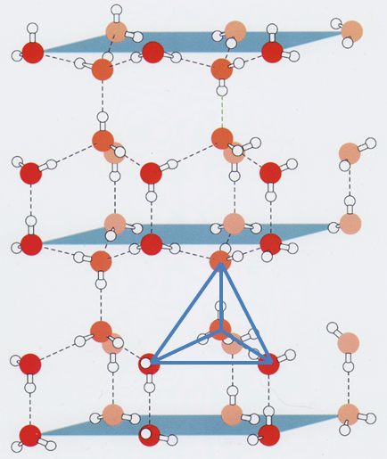
Density – at 4 °C water has a density around 1.0 g mL⁻¹ and can go as low as 0.934 g mL⁻¹ at ‒180 °C. In solid water, molecules arrange themselves in a tetrahedral arrangement such that the water molecules are further apart in ice than in water.
(Serianni 2015)

Slide 3
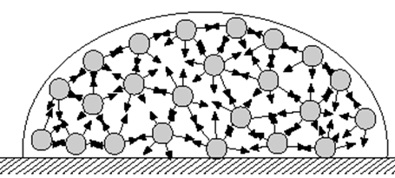
High surface tension – A liquid’s tendency to reduce its surface area. Due to the strong intermolecular forces at the surface of the liquid being unbalanced, causing the molecules to be pulled inwards.
(Leon n.d.)
Water is often referred to as the universal solvent because of the large range of substances (solutes) that are soluble in water. The solubility of (and reasons for) various substances in water are:

Slide 4
Polar substances –solubility in water may be due to favourable hydrogen bonding interactions between the water and polar substance (e.g. methanol in water) or dipole-dipole interactions between the water and polar substance (e.g. hydrogen sulfide in water).
In order for a solute to be soluble in a solvent, the strength of the interactions between the solute and solvent molecules must be strong enough to overcome the solvent-solvent interactions and the solute-solute interactions (i.e. the energy produced from the formation of the solvent-solute interactions must be greater than the energy required to overcome the solute-solute and solvent-solvent interactions).

Slide 5
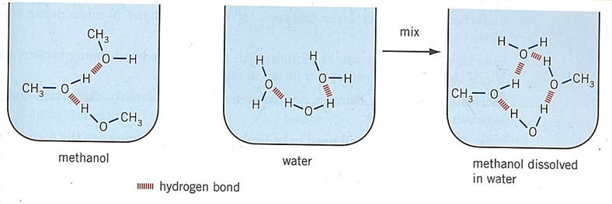
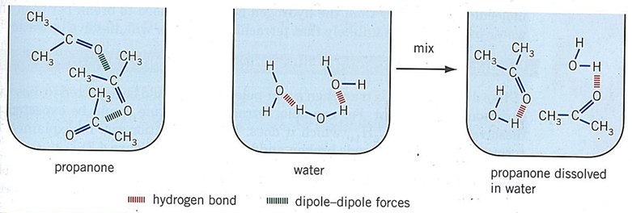
(Cherie Lewis 2012)

Slide 6
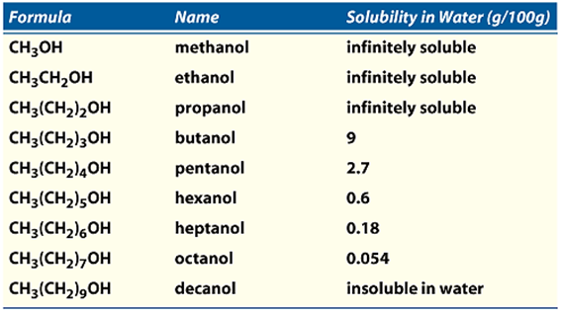
Not all polar substances are soluble in water - dispersion forces can become more and more significant which can then interfere with the favourable intermolecular forces set up between the solute and solvent.
(Rochelle Schwartz-Bloom n.d)

Slide 7
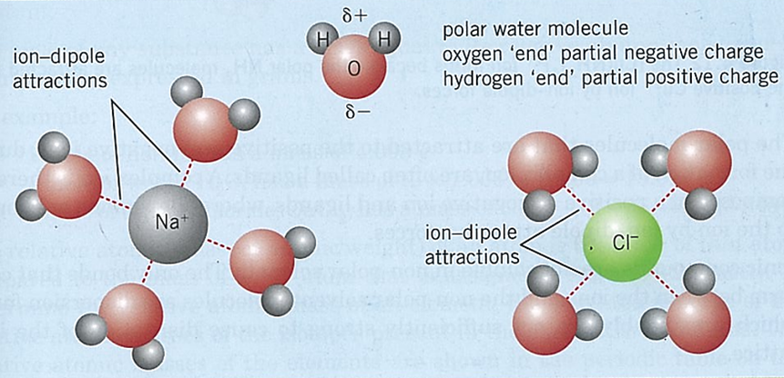
Ionic substances – many are soluble in water due to electrostatic forces of attraction set up between the ions and water molecules called ion-dipole forces. In this type of force positive ions are attracted to the negative end of the water dipole and negative ions are attracted to the positive end of the water dipole.
(Cherie Lewis 2012)

Slide 8
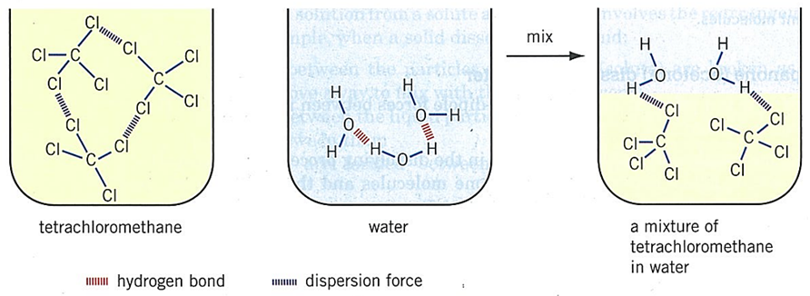
Non-polar substances –tend not to be soluble in water as the energy produced in forming solvent-solute interactions is not strong enough to overcome the solute-solute interactions and solvent-solvent interactions.
In general, as the temperature increases, the solubility of solids and liquids increases in water but the solubility of gases tends to decrease.
(Cherie Lewis 2012)

Slide 9
Solutions and Concentrations
A solution is defined as a homogeneous mixture where the solute is dissolved uniformly throughout the solvent. Dissolved solutes that produce ions are often called electrolytes.
A solution can be unsaturated, saturated or supersaturated.
Unsaturated – a solution in which more solute can still be dissolved under the same conditions of temperature and pressure.

Slide 10
Unsaturated – a solution in which more solute can still be dissolved under the same conditions of temperature and pressure.
Saturated – a solution in which no more solute can be dissolved under the same conditions of temperature and pressure.
Supersaturated – a solution that contains more solute than a saturated solution could normally hold under the same conditions of temperature and pressure.
Many supersaturated solutions are unstable and the presence of dust or the addition of a small quantity of solid solute can cause the excess solute to crystallize (“bomb”) out from the solution.

Slide 11
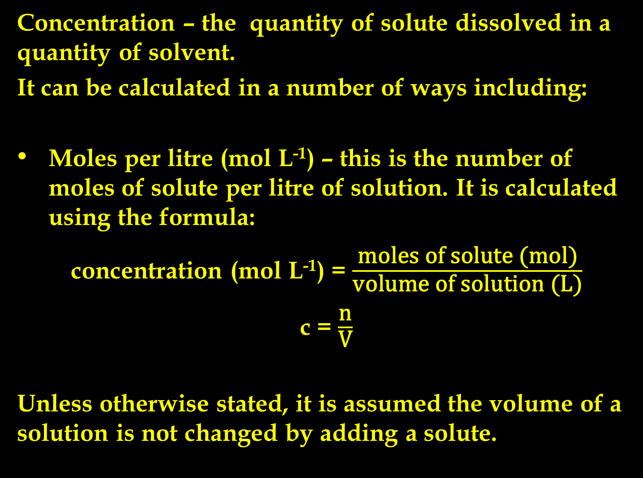
Concentration – the quantity of solute dissolved in a quantity of solvent.
It can be calculated in a number of ways including:
Moles per litre (mol L⁻¹) – this is the number of moles of solute per litre of solution. It is calculated using the formula:
concentration (mol L⁻¹) = $\frac{\text{moles} \text{of} \text{solute}\text{ (}\text{mol}\text{)}}{\text{volume} \text{of} \text{solution}\text{ (}\text{L}\text{)}}$
c = $\frac{\text{n}}{\text{V}}$
Unless otherwise stated, it is assumed the volume of a solution is not changed by adding a solute.

Slide 12
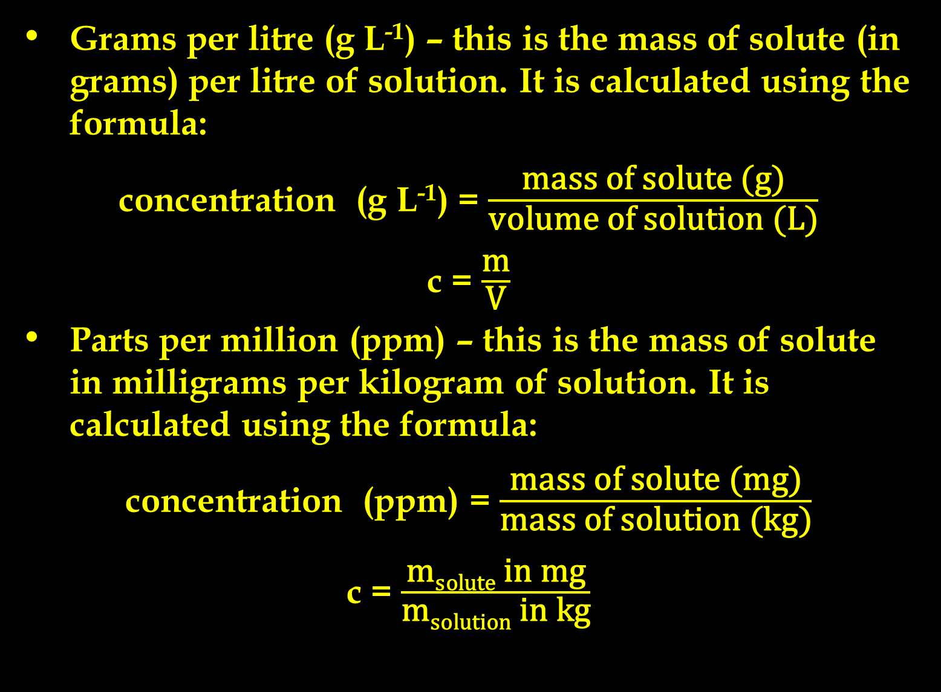
Grams per litre (g L⁻¹) – this is the mass of solute (in grams) per litre of solution. It is calculated using the formula:
concentration (g L⁻¹) = $\frac{\text{mass} \text{of} \text{solute}\text{ (}\text{g}\text{)}}{\text{volume} \text{of} \text{solution}\text{ (}\text{L}\text{)}}$
c = $\frac{\text{m}}{\text{V}}$
Parts per million (ppm) – this is the mass of solute in milligrams per kilogram of solution. It is calculated using the formula:
concentration (ppm) = $\frac{\text{mass} \text{of} \text{solute}\text{ (}\text{m}\text{g}\text{)}}{\text{mass} \text{of} \text{solution}\text{ (}\text{kg}\text{)}}$
c = $\frac{\text{m}\text{solute} \text{in} \text{mg}}{\text{m}\text{solution} \text{in} \text{kg}}$

Slide 13
Precipitation Reactions
The solubility table can be used to determine whether or not an ionic compound will be soluble. If it is soluble, the ions present will be released into the water in a process called dissociation.
E.g.
NaCl_{(s)} → Na⁺_{(aq)} + Cl‒_{(aq)}
Cr₂(SO₄)_{3(s)} → 2Cr³⁺_{(aq)} + 3SO₄²⁻_{(aq)}

Slide 14
In the case of a molecular compound dissolving in water to produce ions, it is called ionisation.
E.g.
HNO_{3(l)} → H⁺_{(aq)} + NO₃‒_{(aq)}
HCN_{(s)} + H₂O_{(l)} ⇋ H₃O⁺_{(aq)} + CN‒_{(aq)}
(note the use of the ⇋ arrow indicates that this ionisation only takes place to a limited extent)

Slide 15
Some ions are coloured in solution.
If they are colourless in solution, the solid compound containing this particular ion will be white (unless paired with another coloured ion). For example, ZnNO₃ solution is colourless and the solid is white.
Some ions have different colours depending upon in which compound they are found. For example, a CuSO₄ solution is blue (as is the solid) but solid CuCO₃ is green whilst CuO is black.
The colour of various solutions can be used to give an idea of what ions could be in the solution.

Slide 16
Precipitation reaction – two solutions containing soluble solutes are mixed together and produce a solid.
For example, suppose a sodium chloride solution is added to a silver nitrate solution. The reaction could be written as:
NaCl + AgNO₃ → AgCl + NaNO₃
but this gives no indication of whether a precipitate is formed. As such, the solubility table is used to determine the states of each substance in the reaction such that:
NaCl_{(aq)} + AgNO_{3(aq)} → AgCl_{(s)} + NaNO_{3(aq)}

Slide 17
For this reaction, the observations written would be:
two colourless solutions are added together to produce a white solid (note that no compounds are named, only generic descriptions).
When writing precipitation reactions (and other types of reactions) often some ions do not take part in the reaction. These are called spectator ions. If we remove the spectator ions, the chemical equation is referred to as an ionic equation. For example, in the previous reaction involving sodium chloride and silver nitrate solution when writing these two solutions, because they are soluble, we can write them in their dissociated form, i.e.
Na⁺_{(aq)} + Cl‒_{(aq)} + Ag⁺_{(aq)} + NO₃‒_{(aq)}

Slide 18
with the products (solid silver chloride and sodium nitrate solution) we can write the solution in its dissociated form but not the solid (as this is insoluble)
AgCl_{(s)} + Na⁺_{(aq)} + NO₃‒_{(aq)}
Putting these two together, we can see that the sodium and nitrate ions appear the same on both sides of the arrow.
Na⁺_{(aq)} + Cl‒_{(aq)} + Ag⁺_{(aq)} + NO₃‒_{(aq)} → AgCl_{(s)} + Na⁺_{(aq)} + NO₃‒_{(aq)}
As such, they are spectators and can be crossed out:
Na⁺_{(aq)} + Cl‒_{(aq)} + Ag⁺_{(aq)} + NO₃‒_{(aq)} → AgCl_{(s)} + Na⁺_{(aq)} + NO₃‒_{(aq)}

Slide 19
Leaving behind the ionic equation which is written as:
Ag⁺_{(aq)} + Cl‒_{(aq)} → AgCl_{(s)}
Notice that both the atoms and charges must balance.
The following substances are written as separated ions:
Soluble ionic compounds in solution
Solutions of strong acids (i.e. HCl, HNO₃, H₂SO₄, HBr and HI)

Slide 20
The following substances are written as ‘normal’ formulae:
Insoluble ionic substances
Covalent molecular or network substances in solid, liquid or gaseous states or in solution
Weak acids (e.g. CH₃COOH, H₂CO₃, H₂SO₃, H₃PO₄, H₂C₂O₄, etc)
Metals

Slide 21
When asked to write observations for chemical reactions the following apply:
The colours of solutions are given on the data sheet. Unless otherwise indicated, assume solid forms of the ions have the same colour as the ion in solution.
If a solution has no colour, it is said to be colourless but if it is a solid with no colour it is white.
Common gases and their colours and odours include; H₂ (colourless, odourless), CO₂ (colourless, odourless), H₂S (colourless, rotten egg odour), SO₂ (colourless, pungent), NH₃ (colourless, pungent), NO₂ (brown, pungent), C­l₂ (greenish-yellow, pungent)
No reference must be made of the identity of the substance. Generic terms such as solid, solution, gas, etc. are to be used.

Slide 22
Precipitation reactions can be used to distinguish between unknown solutions. In this type of question, specific solutions must be identified and the observations of the named unknown solutions must be given.
For example, distinguish between two unlabelled solutions of sodium sulfate and sodium hydroxide.
Note that if a question asks, “Using a chemical test distinguish between…,” you must perform a chemical reaction of some sort (i.e. you cannot use simple solubility in water or the original colour of solutions to determine identities). If the question asks. “Using a test distinguish between…,” then solubility in water and the original colours of solutions are fine.

Slide 23
Acids and Bases
Arrhenius theory of acids and bases was an early attempt at explaining the properties of acids and bases. He suggested:
Acids:
contain H in their formula
produce hydrogen ions in solution
can be strong (i.e. fully ionise in solution e.g. HCl_{(g)} → H⁺_{(aq)} + Cl‒_{(aq)})
can be weak (i.e partially ionise in solution e.g. CH₃COOH_{(g)} ⇋ H⁺_{(aq)} + CH₃COO‒_{(aq)})

Slide 24
Bases:
contain OH in their formula
produce hydroxide ions in solution
completely dissociate in solution (e.g. NaOH_{(s)} → Na⁺_{(aq)} + OH‒_{(aq)})
Although not recognised in the Arrhenius theory of acids and bases, (strong) bases can also contain oxide (e.g. Na₂O, CaO, etc).
In general acids turn blue litmus (an indicator paper) red and taste sour. They conduct an electric current but it depends on the strength of the acid.

Slide 25
Bases, on the other hand, turn red litmus blue, taste bitter, will also conduct an electric current and can have a slippery, soapy feel.
General acid and base reactions include:
acid + reactive metal → salt + hydrogen gas
acid + metal hydroxide (base) → salt + water
acid + metal oxide (base) → salt + water
acid + metal carbonate → salt + carbon dioxide + water
acid + metal hydrogencarbonate → salt + carbon dioxide + water

Slide 26
acid + metal sulfite → salt + sulfur dioxide + water
base + ammonium salt → salt + ammonia + water
base + non-metal oxide → salt + water

Slide 27
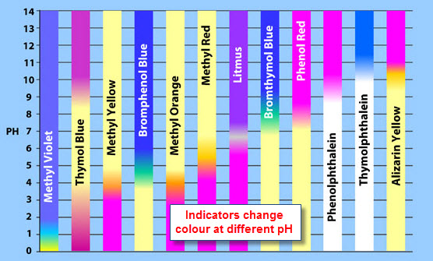
Indicators and pH Scale
An indicator is a solution that changes colour depending on the acidity of the solution it is added to.
(Wong 2013)

Slide 28
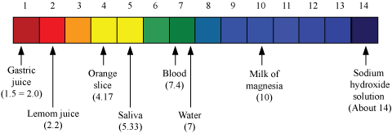
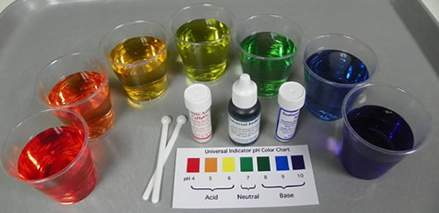
Universal indicator is a mixture of indicators that changes colour over the pH scale from 1 – 14.
(Pandey 2013)
pH Range | Description | Colour
<3 | strong acid | red
3-6 | weak acid | orange/yellow
7 | neutral | green
8-11 | weak base | blue
>11 | strong base | violet/purple
(Universe of Science, Inc 2007)

Slide 29
Universal indicator can be used to help determine whether a solution is acidic, basic or neutral.
The pH scale is dependent on the concentration of hydrogen ions in solution. It is calculated using the formula pH = ‒log₁₀[H⁺].
The greater the concentration of hydrogen ions, the more acidic the solution (and the lower the pH).
The lesser the concentration of hydrogen ions, the more basic the solution (and the higher the pH).

Slide 30
For every pH unit that is increased, the concentration of hydrogen ions present decreases by a factor of 10.
For example, a solution of pH 1 has a hydrogen ion concentration of 1.00×10⁻¹ mol L⁻¹ but a solution of pH 2 has a hydrogen ion concentration of 1.00×10⁻² mol L⁻¹.
A very small amount of water undergoes ionisation to produce hydrogen ions and hydroxide ions according to the equation:
H₂O_{(l)} ⇋ H⁺_{(aq)} + OH‒_{(aq)}
For every water molecule that ionises, an equal number of hydrogen ions and hydroxide ions are produced. These neutralise each other which means a solution of water is neutral and has a pH of 7.

Slide 31
Stoichiometry and Solutions
Using the formula n = cV, calculations involving chemical reactions with solutions can be performed.
For example, calculate the mass of tin (IV) hydroxide produced when 3.45×10⁻¹ L of 1.982×10¹ mol L⁻¹ tin (IV) nitrate reacts with excess sodium hydroxide solution.
Using all the formulae we have learnt throughout the year, it is now possible to perform stoichiometric calculations for chemical equations using solids, liquids, gases and solutions.
For example; calculate the volume of carbon dioxide gas produced at STP when 896 mL of
6.09×10⁻² mol L⁻¹ nitric acid reacts with 3.44 g of solid sodium carbonate.

Slide 32
Bibliography
"Acid & Base Humour." Acids & Bases. n.d. http://professorpopz.weebly.com/humor.html (accessed September 1, 2015).
"Acid Base Chemistry Jokes." PinstoPin. n.d. http://www.pinstopin.com/acid-base-chemistry-jokes/ (accessed September 1, 2015).
Cherie Lewis, Peter Lewis. Chemistry for WA 2 Stage 3: Units 3A and 3B. Melbourne: Pearson Australia, 2012.
Leon, Donald James and Mark. "Surface Tension Driven-Flow." NASA Quest. n.d. http://quest.nasa.gov/space/teachers/microgravity/6surf.html (accessed September 2, 2015).
Love-Lei, DreadieBelle. "I Love Science." Pintrest. n.d. https://www.pinterest.com/DreadieBelle710/i-fkn-love-science/ (accessed September 1, 2015).
Pandey, Shalini. "Acids, Bases and Salts." Meritnation. July 27, 2013. http://www.meritnation.com/ask-answer/question/state-whether-a-litmus-is-a-common-acid-base-indicator-or-a/chemistry/5484869 (accessed September 14, 2015).
Qaydyan, T. Ladders Chemistry. n.d. http://nardbanchem.blogfa.com/ (accessed September 9, 2015).
Rochelle Schwartz-Bloom, Fulton Crews, Linda Porrino, David Friedman, A Leslie Morrow, Kathleen Sulik. "What is Alcohol?" Alcohol Pharmacology Education Partnership. n.d. http://www.rise.duke.edu/apep/pages/page.html?010401 (accessed September 2, 2015).
Serianni, Anthony. "Structure of Ice." Structural Glycoscience at the University of Notre Dame. July 29, 2015. https://www3.nd.edu/~aseriann/ice.html (accessed September 2, 2015).
Starr, Claudia. "Education/Teaching: Science." Pintrest. n.d. https://www.pinterest.com/claudiastar/education-teaching-science/ (accessed September 1, 2015).
Universe of Science, Inc. "Chemistry's Rainbow." Universe of Science, Inc. 2007. http://www.universeofscience.com/chemrainbow.html (accessed September 15, 2015).
Wong, Cikgu. "Chemistry Form 4 - Chapter 7: Examples of Acid-Base Indicator." EduMission. July 8, 2013. http://cikguwong.blogspot.com.au/2013/07/chemistry-form-4-chapter-7-examples-of.html (accessed September 15, 2015).

